Slide 1
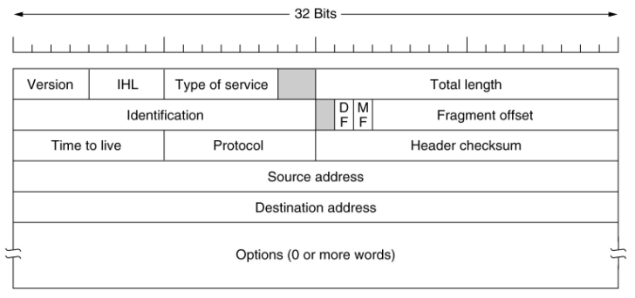
IPv4 Header

Slide 2
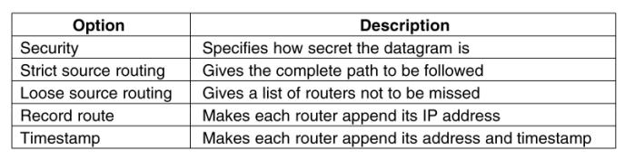
IPv4 Options

Slide 3
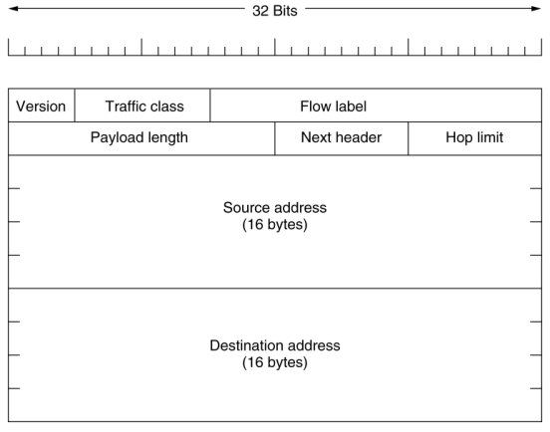
IPv6 Header

Slide 4
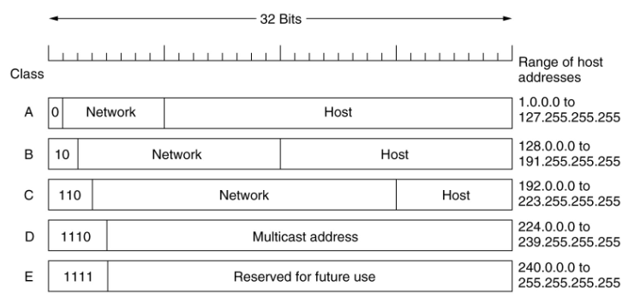
IP Addresses
Every host and router on Internet has a unique IP address
  Encodes network number and host number

Slide 5
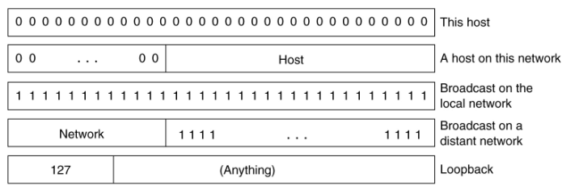
IP Addresses
Special IP addresses

Slide 6
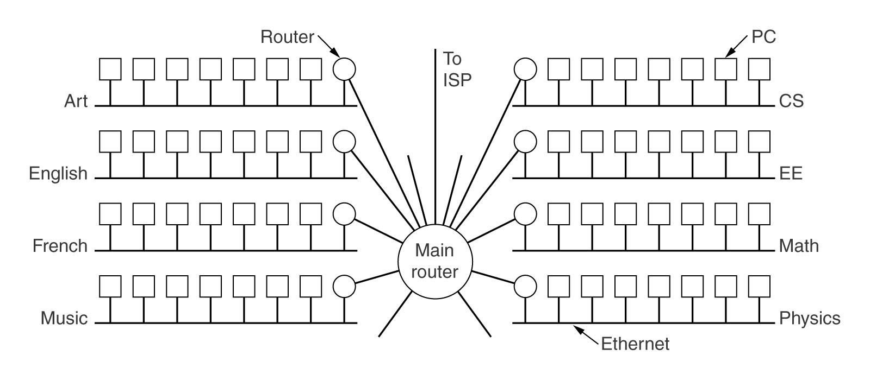
Subnetting Example

Slide 7
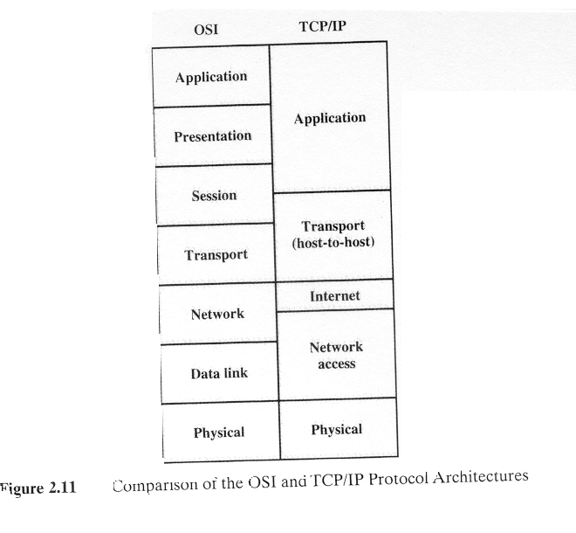
OSI vs TCP/IP

Slide 8
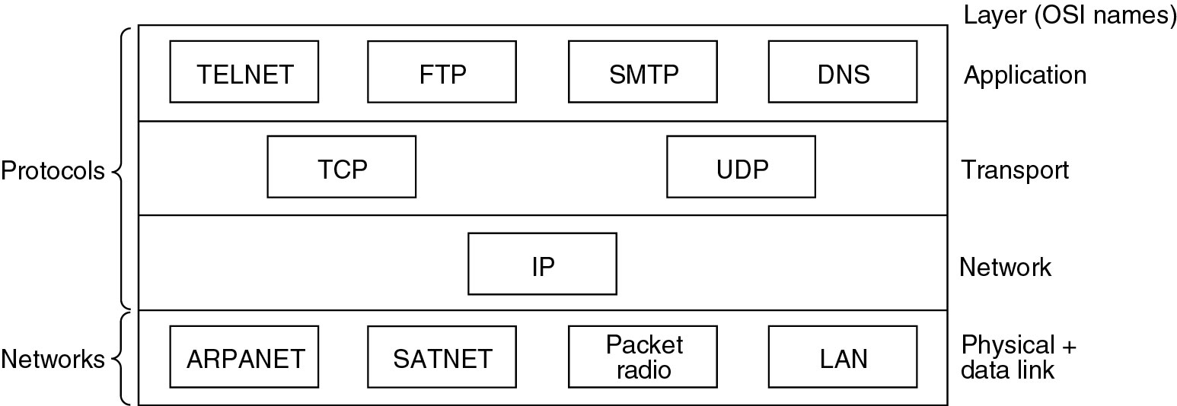
TCP/IP Protocols and Networks

Slide 9
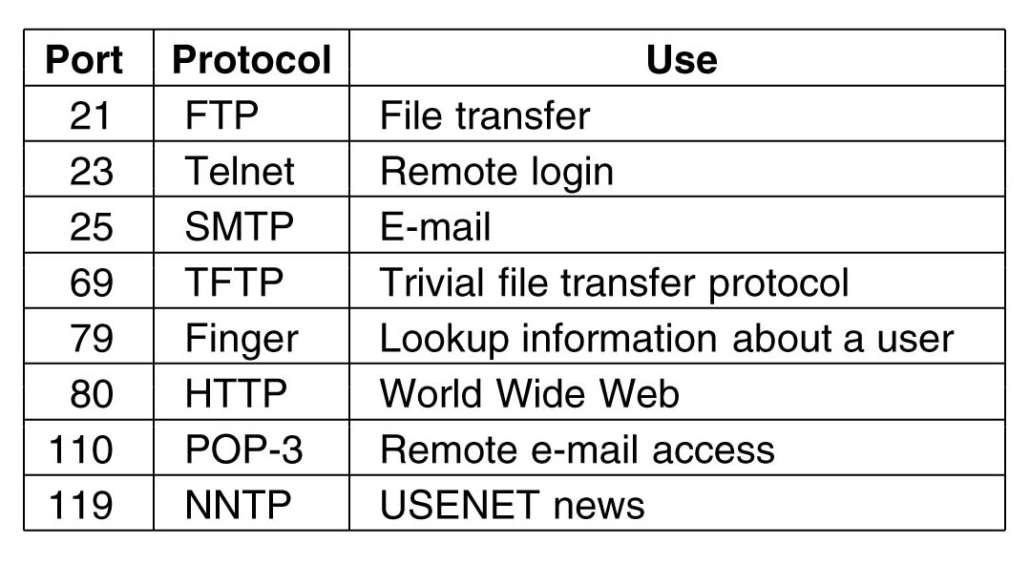
Ports Reserved for Standard Services

Slide 10
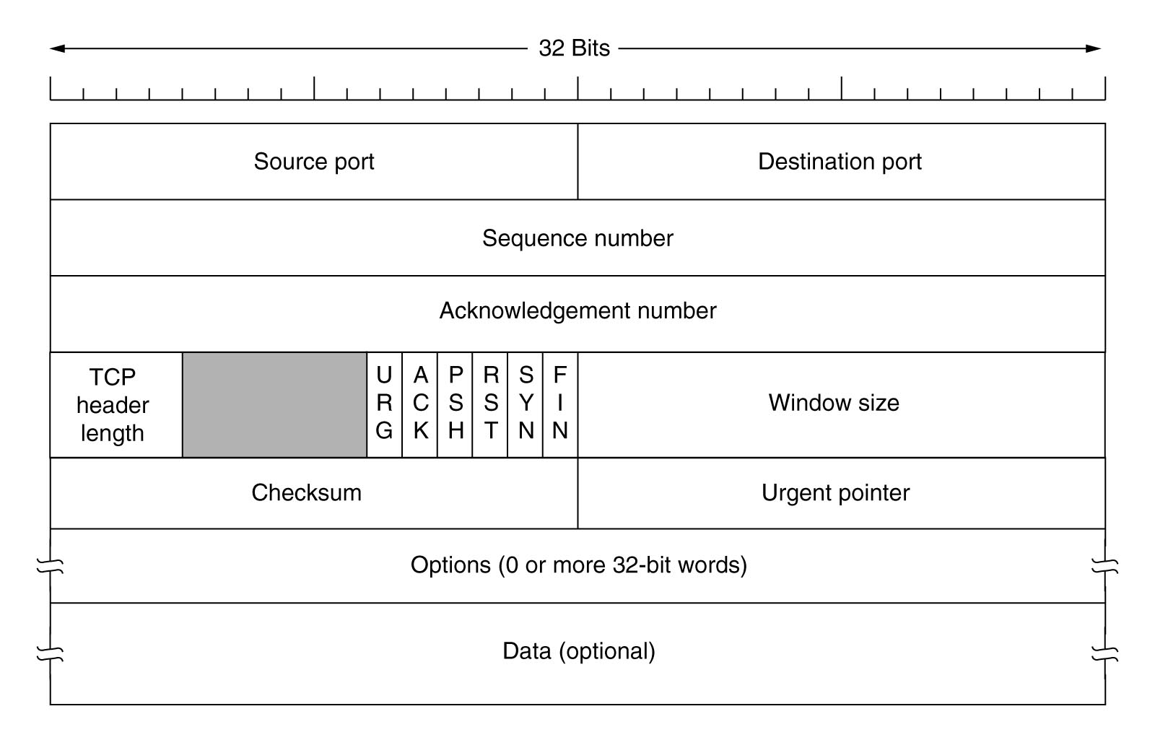
TCP Segment

Slide 11
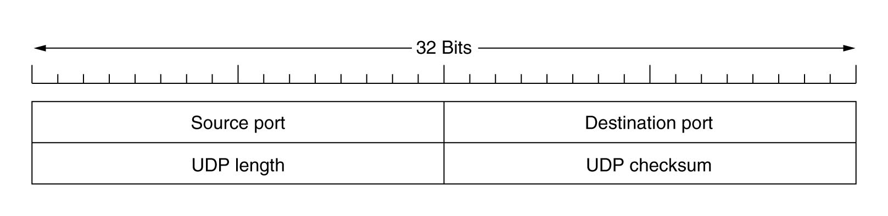
UDP Header

Slide 12
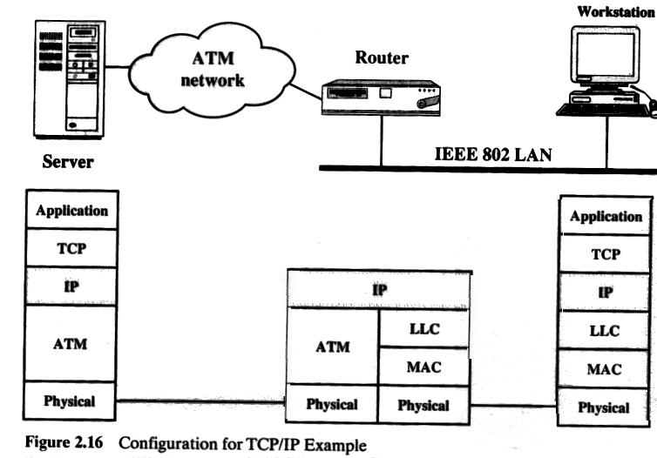
TCP/IP Example

Slide 13
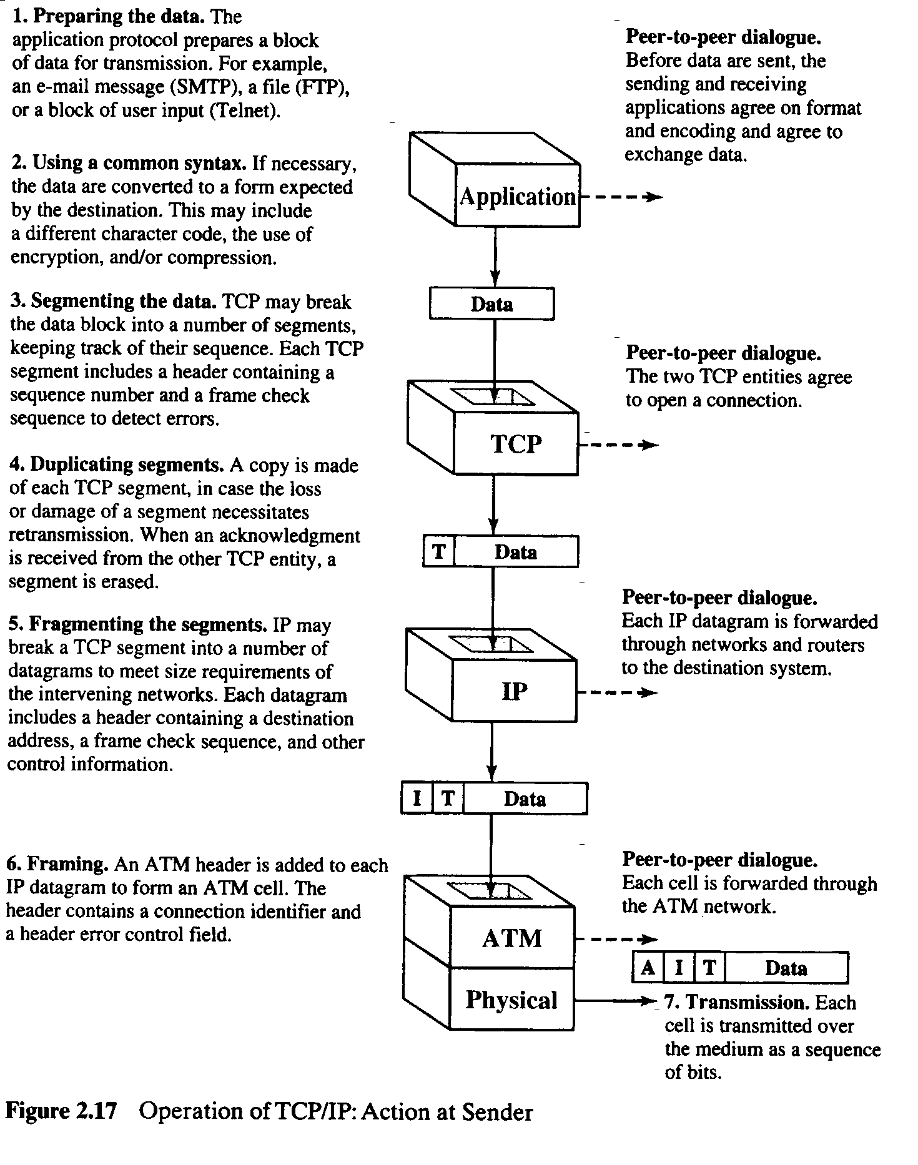
TCP/IP Example

Slide 14
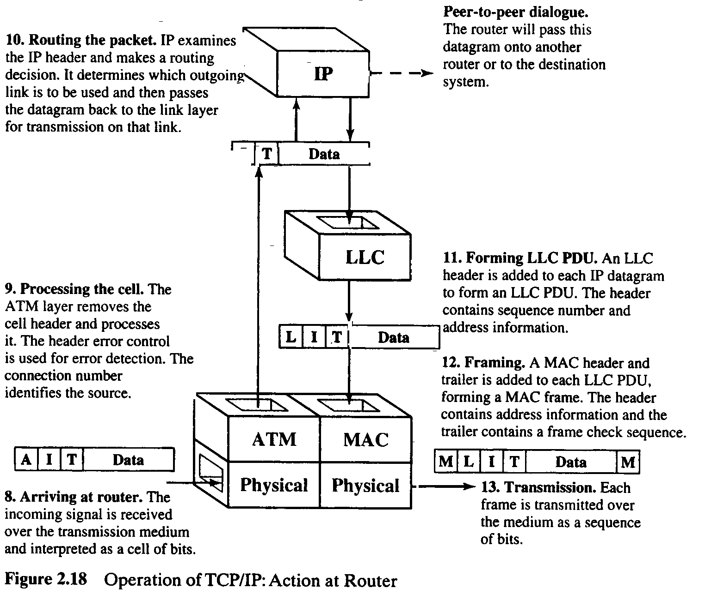
TCP/IP Example

Slide 15
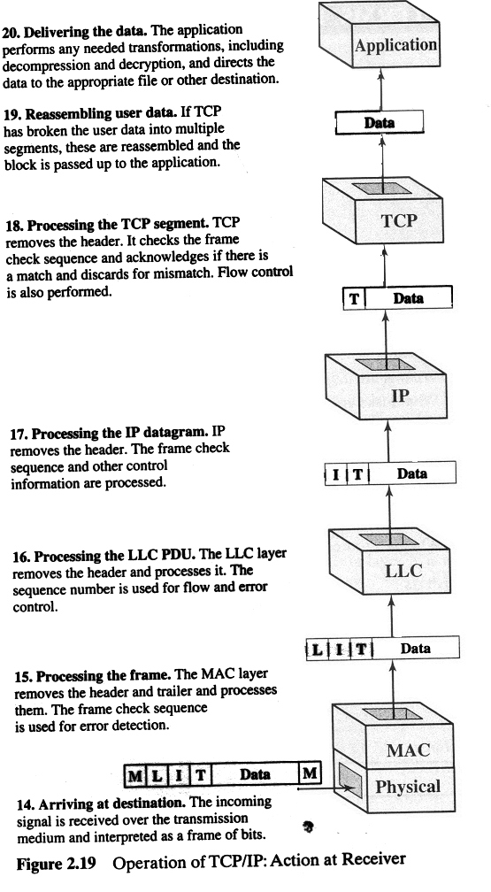
TCP/IP Example

